Slide 1
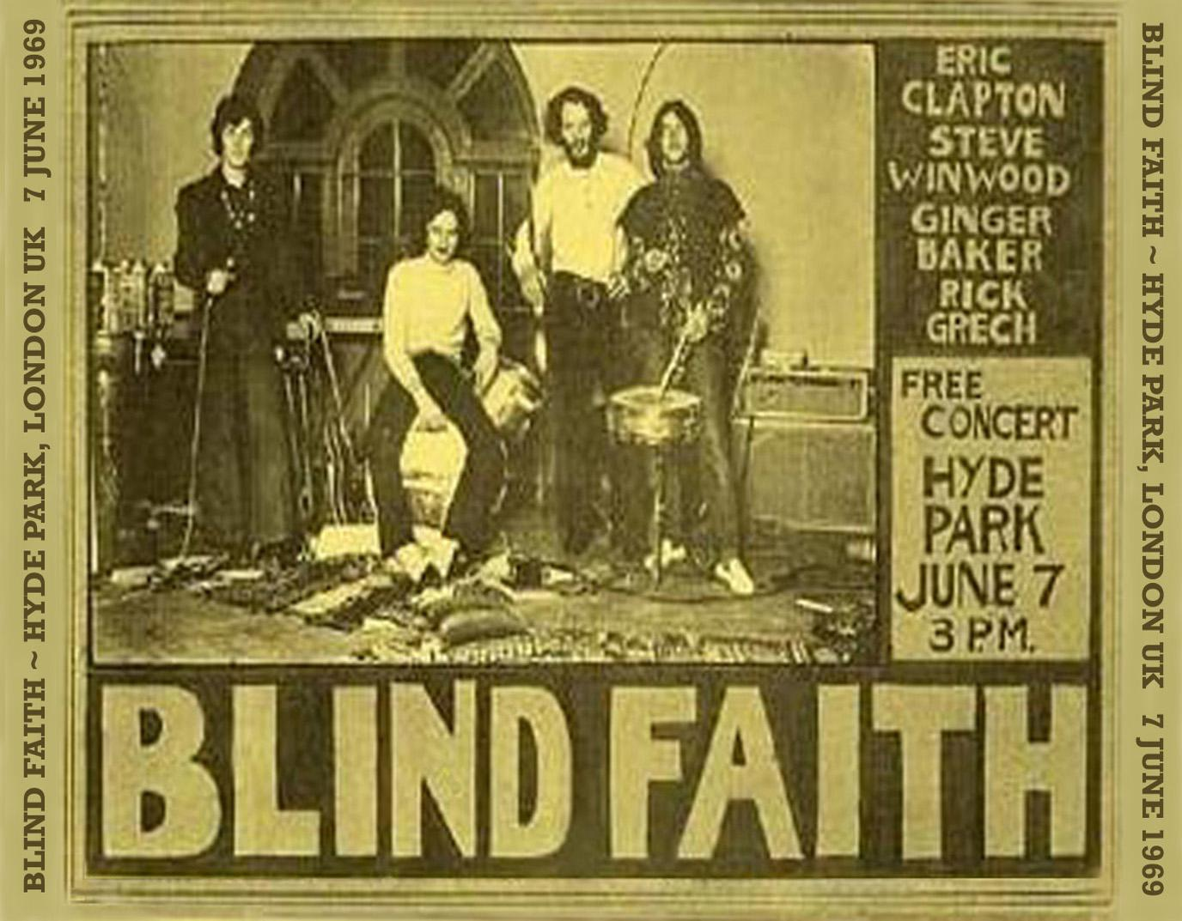
BLIND FAITH
Seeing what is meant

Slide 2
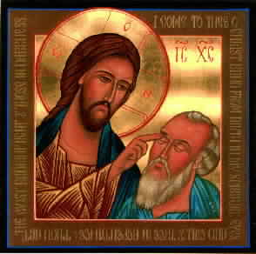
Today’s Scripture
John 9:1-41
Notes:
http://blog.emergingscholars.org/wp-content/uploads/2013/10/Jesus-cures-the-man-born-blind.jpg
John 9:1-41
As he walked along, he saw a man blind from birth. His disciples asked him, “Rabbi, who sinned,
this man or his parents, that he was born blind?” Jesus answered, “Neither this man nor his
parents sinned; he was born blind so that God’s works might be revealed in him. We must work
the works of him who sent me while it is day; night is coming when no one can work. As long as
I am in the world, I am the light of the world.” When he had said this, he spat on the ground and
made mud with the saliva and spread the mud on the man’s eyes, saying to him, “Go, wash in the
pool of Siloam” (which means Sent). Then he went and washed and came back able to see.
The neighbors and those who had seen him before as a beggar began to ask, “Is this not the man
who used to sit and beg?” Some were saying, “It is he.” Others were saying, “No, but it is someone
like him.” He kept saying, “I am the man.” But they kept asking him, “Then how were your eyes
opened?” He answered, “The man called Jesus made mud, spread it on my eyes, and said to me, ‘Go
to Siloam and wash.’ Then I went and washed and received my sight.” They said to him, “Where is
he?” He said, “I do not know.”
They brought to the Pharisees the man who had formerly been blind. Now it was a sabbath day
when Jesus made the mud and opened his eyes. Then the Pharisees also began to ask him how he
had received his sight. He said to them, “He put mud on my eyes. Then I washed, and now I see.”
Some of the Pharisees said, “This man is not from God, for he does not observe the sabbath.” But
others said, “How can a man who is a sinner perform such signs?” And they were divided. So they
said again to the blind man, “What do you say about him? It was your eyes he opened.” He said,
“He is a prophet.” The Jews did not believe that he had been blind and had received his sight until
they called the parents of the man who had received his sight and asked them, “Is this your son,
who you say was born blind? How then does he now see?” His parents answered, “We know that
this is our son, and that he was born blind; but we do not know how it is that now he sees, nor
do we know who opened his eyes. Ask him; he is of age. He will speak for himself.” His parents
said this because they were afraid of the Jews; for the Jews had already agreed that anyone who
confessed Jesus to be the Messiah would be put out of the synagogue. Therefore his parents said,
“He is of age; ask him.” So for the second time they called the man who had been blind, and they
said to him, “Give glory to God! We know that this man is a sinner.” He answered, “I do not know
whether he is a sinner. One thing I do know, that though I was blind, now I see.” They said to
him, “What did he do to you? How did he open your eyes?” He answered them, “I have told you
already, and you would not listen. Why do you want to hear it again? Do you also want to become
his disciples?” Then they reviled him, saying, “You are his disciple, but we are disciples of Moses.
We know that God has spoken to Moses, but as for this man, we do not know where he comes
from.” The man answered, “Here is an astonishing thing! You do not know where he comes from,
and yet he opened my eyes. We know that God does not listen to sinners, but he does listen to one
who worships him and obeys his will. Never since the world began has it been heard that anyone
opened the eyes of a person born blind. If this man were not from God, he could do nothing.” They
answered him, “You were born entirely in sins, and are you trying to teach us?” And they drove
Jesus heard that they had driven him out, and when he found him, he said, “Do you believe in the
Son of Man?” He answered, “And who is he, sir? Tell me, so that I may believe in him.” Jesus said to
him, “You have seen him, and the one speaking with you is he.” He said, “Lord, I believe.” And he
worshiped him.
Jesus said, “I came into this world for judgment so that those who do not see may see, and those
who do see may become blind.” Some of the Pharisees near him heard this and said to him, “Surely
we are not blind, are we?” Jesus said to them, “If you were blind, you would not have sin. But now
that you say, ‘We see,’ your sin remains.

Slide 3
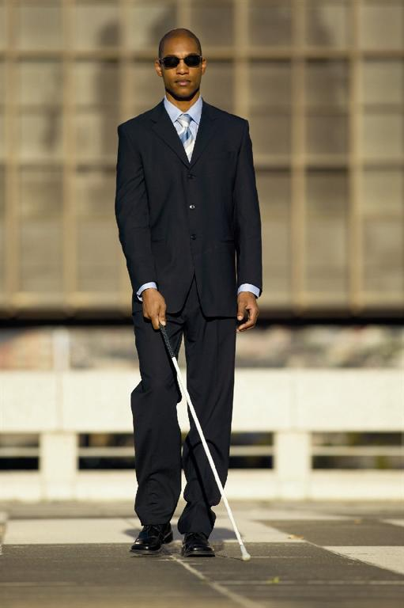
Why is the man blind?
Notes:
The story says the man is blind to help reveal God’s works are reveal in him. What does the crowd in the narrative think about the blind man?
Does this mean that God made the man suffer so he could prove a point?

Slide 4
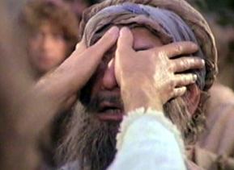
How does Jesus heal him?
Notes:
Spits in mud and rubs it on his eyes? What do you think about this? Does this remind you of a magic show? Do you know what story this is trying to invoke?

Slide 5

The audience
Notes:
The audience is an important part of the story. It adds credence to the Jesus’ deeds.
They are playing the skeptic to reinforce the idea in the story.
Similar to a person in a commercial.

Slide 6
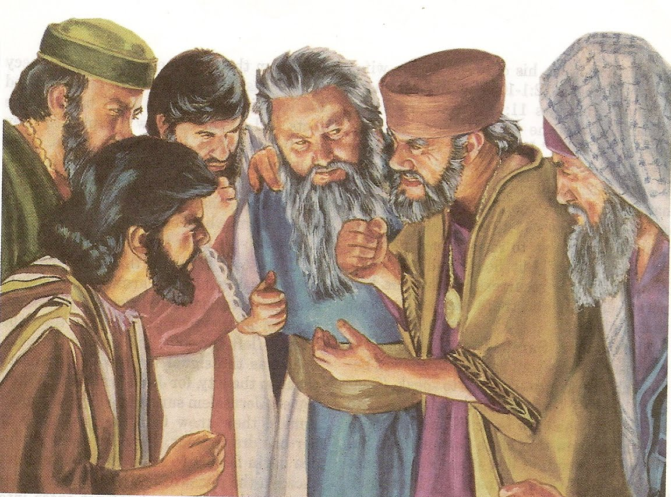
The Pharisees
Notes:
These are the “good people in the worst meaning of that phrase” people. They are considered by all to the most pious people.
Do you know why they are this pious, i.e.- what are their motives?
Why is Jesus often pitted against these people?
What does this reveal to us about Jesus?

Slide 7

The Rulez
Notes:
Pharisees love rules. They are letter of the law kind of people.
What rule are the protesting that Jesus broke?

Slide 8
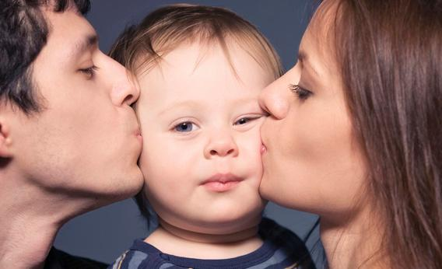
The parents verification
Notes:
Why does the story call other witnesses after the Pharisees? Why do the parents say ask the son himself?

Slide 9
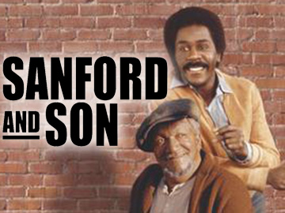
The son
Notes:
I told you already. How do the Pharisees reply- we are disciples of Moses.
He says “God does not listen to sinners” but to those who worship him. What do you think of this?
What does that mean if we are “sinners” who want a way back to God?
The Pharisees are saying- you are born in sin, how are you going to teach us?

Slide 10
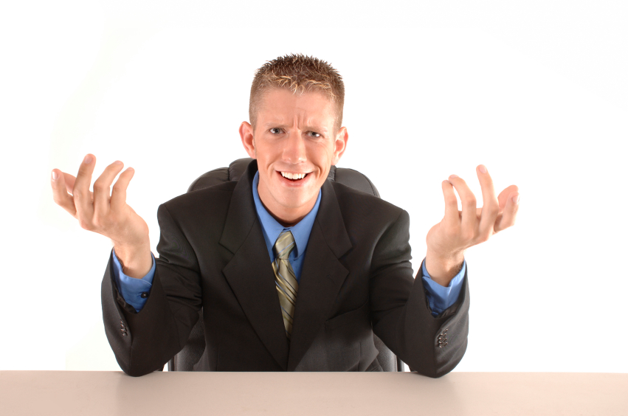
Jesus rescues and scolds
Notes:
Asks if the ex-blind person agrees? What is meant by this?

Slide 11
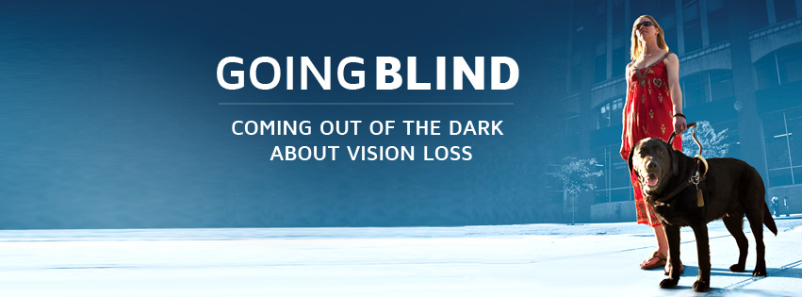
Jesus sums it up
Notes:
Not for judgment but for the world to see. Does the blindness now seem like a metaphor?
Turns around the idea so that the Pharisees are the sinners.

Slide 12

Save the Cat!
Notes:
Blake Snyder notes that to easy convey to the user that someone is the hero in your screenplay, you should have the hero “save the cat” or help someone or something that is helpless.

Slide 13
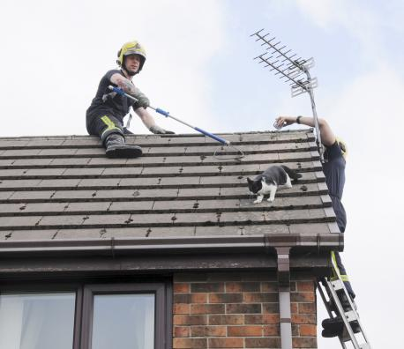
The hero rescues the helpless

Slide 14
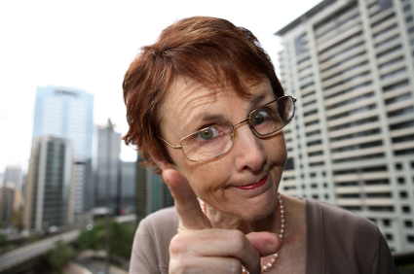
The hero scolds the villain

Slide 15
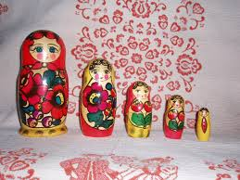
The story within the story
Notes:
Subtext. Blindness means not seeing both literally and figuratively.

Slide 16

Making sense of the story
Notes:
This story hinges on the difference of a physical sense and it’s literal meaning.
Embodied cognition. Lackoff- Women, Fire and Dangerous Things.

Slide 17

Your sense story
Notes:
What other senses can be used this way? Hearing, Feeling, Tasting, Smelling.
Can you make a story with these?

